Slide 1


Slide 2
Normality and Abnormality
In behavior, Normal refers to a lack of significant deviation from the average.
Abnormality, in the sense of something deviating from the normal or differing from the typical , is a subjectively defined behavioral characteristic, assigned to those with rare or dysfunctional conditions. Defining who is normal or abnormal is a contentious issue in abnormal psychology.
Abnormal behavior is defined as behavior that causes people to experience distress/agony and prevents them from functioning in their daily lives.

Slide 3
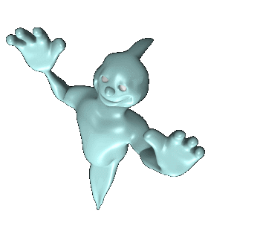
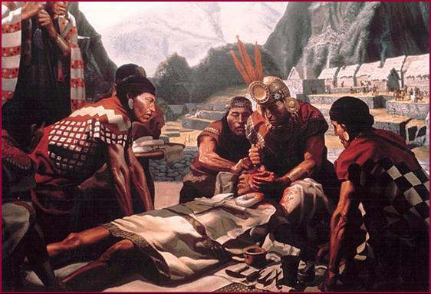
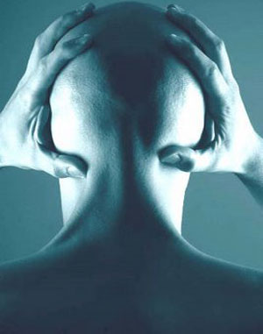
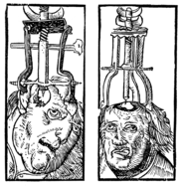
Early Theories
Abnormal behavior was Thought of as possession of evil spirits or demons.
Trephining was often used.Exorcism,drowning,burning etc

Slide 4
Perspectives on Abnormality
Medical Perspective
- Suggests symptoms of abnormal behavior are rooted in physiological causes.
Psychoanalytic perspective
- Views abnormal behavior as stemming from childhood conflicts over opposing wishes regarding sex and aggression.

Slide 5
Behavioral perspective
– View abnormal behavior as a learned response.
Cognitive perspective
– Assumes that cognitions (people’s thoughts and beliefs) are central to a person’s abnormal behavior.
Socio cultural perspective
– Makes the assumption that people’s behavior both normal and abnormal is shaped by the kind of family group, society, and culture.

Slide 6
DSM VI
The Diagnostic and Statistical Manual of Mental Disorders, Fourth Edition (DSM-VI) is published by the American Psychiatric Association. It's a comprehensive term for all mental health and psychological disorders in adults and children. Not only does it list the names and symptoms of psychological disorders, it also includes possible causes, treatments, statistics, and research.

Slide 7
NEUROSIS
1) Neurosis is a general term referring to mental distress that, unlike psychosis, does not prevent rational thought or daily functioning.
2) A neurotic retains the ability to perceive reality, and to control his consciousness and his actions (this control is merely more difficult for him than for a healthy person).
PSYCHOSIS
Psychosis is a generic psychiatric term for a mental state involving the loss of contact with reality, causing the deterioration of normal social functioning.
a psychotic is presumed to suffer from a total break with reality and to have no control over his actions or the operations of his consciousness (and even this is not always true).

Slide 8
3) neurotic conditions do not impair or interfere with normal day to day functions, but rather create the very common symptoms of depression, anxiety, or stress. It is believed that most people suffer from some sort of neurosis as a part of human nature.
3) psychosis refers to any mental state that impairs thought, perception, and judgment. Psychotic episodes might affect a person with or without a mental disease. A person experiencing a psychotic episode might hallucinate, become paranoid, or experience a change in personality.

Slide 9
NEUROSIS
Anxiety Disorder
Somatoform Disorder
Dissociative Disorder
Mood Disorder

Slide 10
Anxiety Disorder
“An anxiety disorder involves an excessive or inappropriate state of arousal characterized by feelings of apprehension, uncertainty, or fear.”

Slide 11
Types Of Anxiety
Generalized Anxiety Disorder:
Generalized anxiety disorder is a common chronic disorder characterized by long-lasting anxiety that is not focused on any one object or situation. Those suffering from generalized anxiety experience non-specific persistent fear and worry and become overly concerned with everyday matters. Symptoms can be headach,fatigue,insomnia,gastrointestinal.dizziness, irritability

Slide 12
Panic disorder
In panic disorder, a person suffers from brief attacks of intense terror and apprehension, often marked by trembling, shaking, confusion, dizziness, nausea, difficulty breathing.
Phobia:
The single largest category of anxiety disorders is that of Phobia, which includes all cases in which fear and anxiety is triggered by a specific stimulus or situation.
(Site: List of Phobias: http://www.ojohaven.com/fun/phobias.html )

Slide 13
Obsessive-compulsive disorder
Obsessive compulsive disorder is a type of anxiety disorder primarily characterized by repetitive obsessions (distressing, persistent, and intrusive thoughts or images) and compulsions (urges to perform specific acts or rituals).
Post-traumatic stress disorder
Post-traumatic stress disorder or PTSD is an anxiety disorder which results from a traumatic experience. Post-traumatic stress can result from an extreme situation, such as combat, rape, hostage situations, or even serious accident.

Slide 14
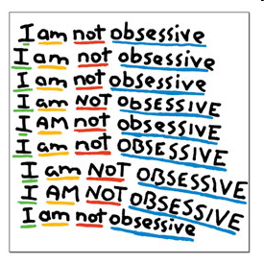

OCD

Slide 15
SOMATOFORM DISORDER
Physical symptoms that mimic disease or injury for which there is no identifiable physical cause or physical symptoms such as pain, nausea, depression, and dizziness.

Slide 16
Types of Somatoform Disorder
Hypochondriasis:
Refers to an excessive preoccupation or worry about having a serious illness. Often, hypochondria persists even after a physician has evaluated a person and reassured them that their concerns about symptoms do not have an underlying medical basis or, if there is a medical illness, the concerns are far in excess of what is appropriate for the level of disease.

Slide 17
Conversion disorder:
Is a condition where patients present with neurological symptoms such as numbness, paralysis, or fits, but where positive physical signs of hysteria can be found.

Slide 18
Dissociative disorders
Dissociative disorders are defined as conditions that involve disruptions or breakdowns of memory, awareness, identity and/or perception.

Slide 19
Types of Dissociative Disorder
Amnesia:
Is a disorder characterized by abnormal memory functioning in the absence of structural brain damage or a known neurobiological cause; severe cases are very rare.
Fugue:
Is a rare psychiatric disorder characterized by reversible amnesia for personal identity, including the memories, personality and other identifying characteristics of individuality.

Slide 20

Multiple personality disorder (MPD):
It is a psychiatric disorder characterized by having at least one "alter" personality that controls behavior.

Slide 21
Mood Disorders
Mood disorders are mental disorders characterized by periods of depression, sometimes alternating with periods of elevated mood.

Slide 22
Types Of Mood Disorder
Major depressive disorder:
Is a mental disorder characterized by a pervasive low mood, low self-esteem, and loss of interest or pleasure in normally enjoyable activities.

Slide 23
Bipolar disorder:
Is a psychiatric diagnosis that describes a category of mood disorders defined by the presence of one or more episodes of abnormally elevated mood clinically referred to as mania or, if milder, hypomania. Individuals who experience manic episodes also commonly experience depressive episodes or symptoms, or mixed episodes in which features of both mania and depression are present at the same time.

Slide 24
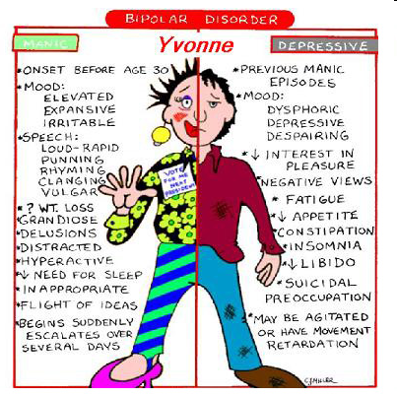

Slide 25
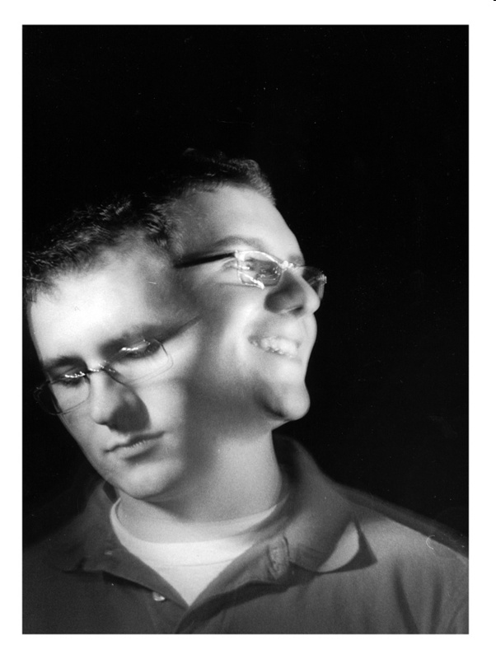

Slide 26
Suicide:
Suicide is a very real issue for those with bipolar disorder (manic depression). The estimates are as high as 20% of people who suffer from Bipolar Disorder will kill themselves. That's one out of every five! And as many as 50% - half! - of all people with this disorder may attempt suicide at least once in their lives.

Slide 27
PSYCHOSIS
Schizophrenia
Personality Disorder

Slide 28
Schizophrenia
It is a psychiatric diagnosis that describes a mental disorder characterized by abnormalities in the perception or expression of reality. It most commonly manifests as auditory hallucinations, paranoid or bizarre delusions, or disorganized speech and thinking with significant social or occupational dysfunction.

Slide 29
Symptoms
Delusions
Hallucinations
Disorganized speech
Disorganized behavior

Slide 30
Causes
Genetic causes of schizophrenia
Environmental causes of schizophrenia
Brain chemical imbalances
Abnormal brain structure

Slide 31
Types of Schizophrenia
Disorganized /Hebephrenic schizophrenia:
People with this type often are confused and incoherent, and have jumbled speech. Their outward behavior may be emotionless or flat or inappropriate, even silly or childlike. Often they have disorganized behavior that may disrupt their ability to perform normal daily activities such as showering or preparing meals.

Slide 32
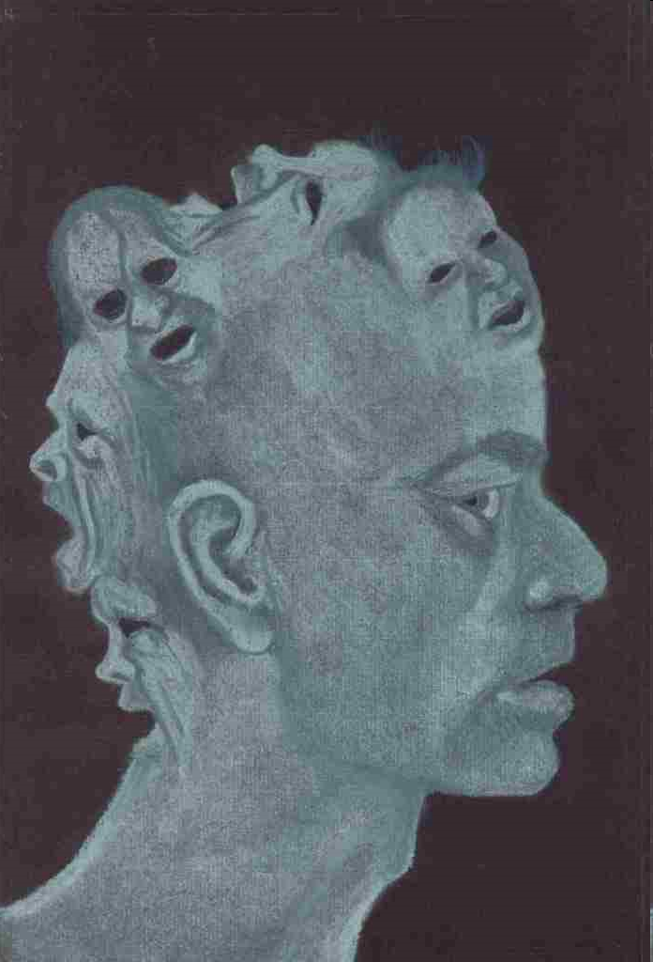
Paranoid schizophrenia: People with this type are preoccupied with false beliefs (delusions) about being persecuted or being punished by someone. Their thinking, speech and emotions, however, remain fairly normal.

Slide 33
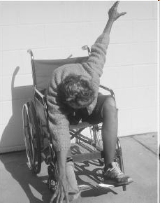
Catatonic schizophrenia:
The most striking symptoms of this type are physical. People with catatonic schizophrenia are generally immobile and unresponsive to the world around them. They often become very rigid and stiff, and unwilling to move. Occasionally, these people have peculiar movements like grimacing or assume bizarre postures. Or, they might repeat a word or phrase just spoken by another person. People with catatonic schizophrenia are at increased risk of malnutrition, exhaustion, or self-inflicted injury.

Slide 34
Undifferentiated schizophrenia: This subtype is diagnosed when the person's symptoms do not clearly represent one of the other three subtypes.
Residual Schizophrenia: In this type of schizophrenia, the severity of schizophrenia symptoms has decreased. Hallucinations, delusions, or other symptoms may still be present but are considerably less than when the schizophrenia was originally diagnosed.

Slide 35
Treatment
Medication
Therapy
ECT

Slide 36
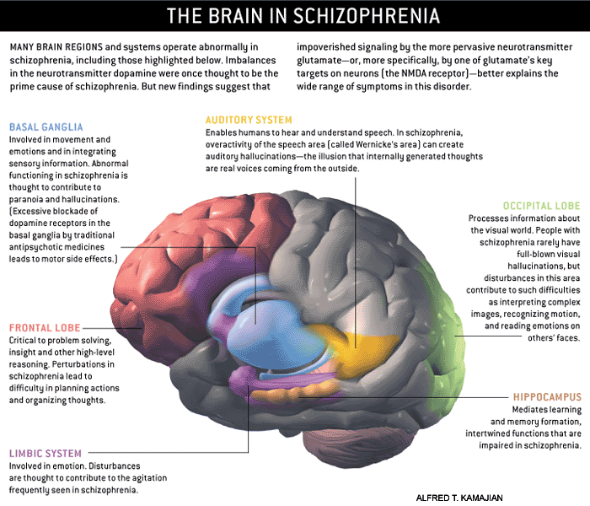

Slide 37
Personality disorders
Personality disorders, formerly referred to as character disorders, are a class of personality styles which deviate from the contemporary expectations of a society.

Slide 38
Symptoms:
Aggression
Substance misuse
Dependence on others
Deceitfulness
Disregard for others
Lack of emotion and remorse
Hypersensitivity to criticism
Anxiety
Depression
Seeking approval for others

Slide 39
Causes:
Parental upbringing in childhood,
Genetic
Environmental Factors

Slide 40
The DSM-IV lists ten personality disorders, grouped into three clusters.
Cluster A (odd or eccentric disorders)
      Paranoid personality disorder: characterized by irrational suspicions and mistrust of others
      Schizoid personality disorder: lack of interest in social relationships, seeing no point in sharing time with others
      Schizotypal personality disorder: also avoids social relationships, though out of a fear of people

Slide 41
Cluster B (dramatic, emotional, or erratic disorders)
      Antisocial personality disorder: "pervasive disregard for the law and the rights of others."
      Borderline personality disorder: extreme "black and white" thinking, instability in relationships, self-image, identity and behavior
      Histrionic personality disorder: "pervasive attention-seeking behavior including inappropriate sexual seductiveness and shallow or exaggerated emotions"
      Narcissistic personality disorder: "a pervasive pattern of grandiosity, need for admiration, and a lack of empathy"

Slide 42
Cluster C (anxious or fearful disorders)
      Avoidant personality disorder: social inhibition, feelings of inadequacy, extreme sensitivity to negative evaluation and avoidance of social interaction
      Dependent personality disorder: pervasive psychological dependence on other people.
      Obsessive-compulsive personality disorder (not the same as obsessive-compulsive disorder): characterized by rigid conformity to rules, moral codes, and excessive orderliness

Slide 43
Antisocial personality disorder
Antisocial personality disorder (ASPD) is defined as “...a pervasive pattern of disregard for, and violation of, the rights of others that begins in childhood or early adolescence and continues into adulthood.”
People having antisocial personality disorder are sometimes referred to as "sociopaths" and "psychopaths"

Slide 44


Slide 45


Slide 46
Psychotherapy
Psychotherapy is an intentional interpersonal relationship used by trained psychotherapists to aid a client in problems of living. It aims to increase the individual's sense of well-being and reduce their subjective sense of discomfort. Psychotherapists employ a range of techniques based on experiential relationship building, dialogue, communication and behavior change and that are designed to improve the mental health of a client or patient, or to improve group relationships (such as in a family).

Slide 47
Goals of Psychotherapy
Relief from distressing symptoms of anxiety or depression
• Better ways of handling the stress of difficult situations like a major medical illness,
the death of a loved one, the break-up of a romantic relationship, or some other stressful event
• The ability to make wiser, more satisfying choices about work and personal issues
• The emotional peace that can come from a fuller, more balanced and more accurate view of
your own strengths, needs, style, vulnerabilities, values, and resources
• A greater ability to build and maintain relationships that bring out the best in you and others
• Freedom from paralyzing doubts and uncertainties
• Greater ability to take responsibility for your own decisions and actions and hold others
accountable for theirs
• A way out of repetitive, destructive cycles of behavior that cause you or others needless
pain
• A sense of being both more grounded and more alive

Slide 48
History of Psychotherapy
People have tried to explain and control abnormal behavior for thousands of years.
Historically, there have been three main approaches to abnormal behavior:
the supernatural
biological
psychological traditions

Slide 49
In the supernatural tradition, abnormal behaviors are attributed to agents outside human bodies. According to this model, abnormal behaviors are caused by demons, spirits, or the influences of moon, planets, and stars. During the Stone Age, trepanning or trephiningwas performed on those who had mental illness to literally cut the evil spirits out of the victim's head. The Ancient Chinese, Egyptians, and Hebrews, on the other hand, believed that these evil demons were punishments from God, and advocated exorcism. By the time of the Greeks and Romans, mental illnesses were thought to be caused by an imbalance of the four humors, leading to draining of fluids from the brain. During the Dark Ages, many Europeans believed that the power of witches, demons, and spirits caused abnormal behaviors. People with psychological disorders were thought to be possessed by evil spirits that had to be exorcised through religious rituals. If exorcism failed, some authorities advocated steps such as confinement, beating, and other types of torture to make the body uninhabitable by witches, demons, and spirits.

